Slide 1

Aerospace Industry
Made by:-
Dhairya Changela
Darsh Turakhia
Aayushi Sawant

Slide 2
Contents
Work Distribution
Project outflow
Organizational Unit Creation
Location Creation
Organizational Structure
User Creation
Role Creation
Service to add users
Service for policy creation
Policy Creation
Some links and Information

Slide 3
Work Distribution
Dhairya
Creating organizational structure
IDI service creation and importing users
Linux Service
Darsh
Identity Policy
Provisioning Policy
Generating Data (CSV files)
Roles creation
Aayushi
Documentation
Company workflow design
Password Policy Creation And Verification

Slide 4
Project Outflow
Project Research
Company Workflow Design
Project Development / Implementation

Slide 5
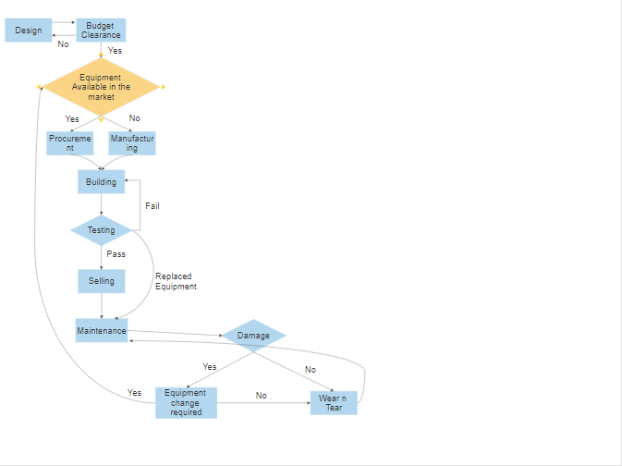
Companies Workflow

Slide 6
Organizational Unit Creation Details
The organizational units have been created keeping in mind the needs and workflow of the company.
The company is very strong financially, thus it does not require a tech support.
The company has only 3 admin users.
The company has 7 supervisors for each department.
The company has an employee count of 376 in 7 different departments.
The company manufactures aircraft related to the commercial, helicopter and space fields.

Slide 7
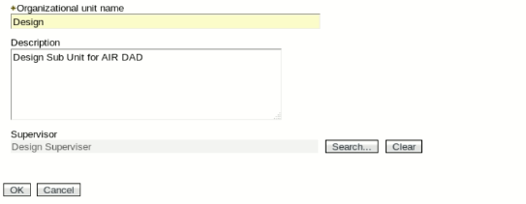
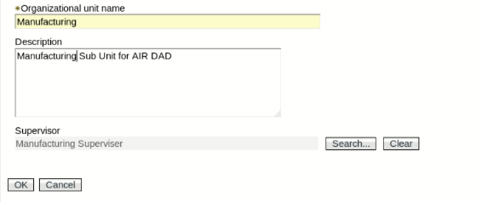
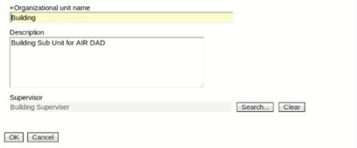
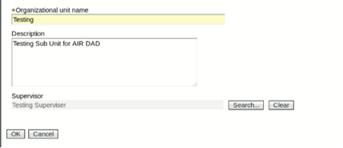
Organizational Unit Creation
Design Unit
Manufacturing Unit
Building Unit
Testing Unit

Slide 8
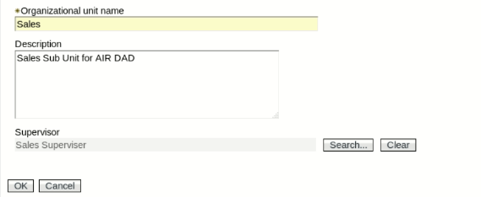
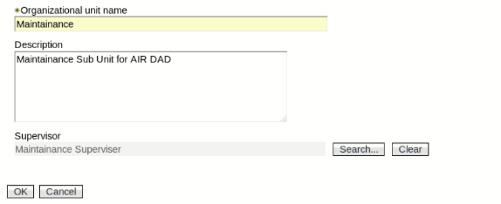
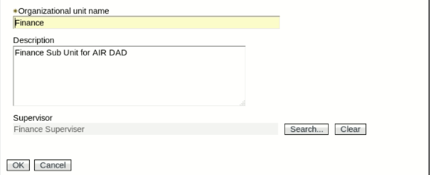
Sales Unit
Maintenance Unit
Finance Unit

Slide 9
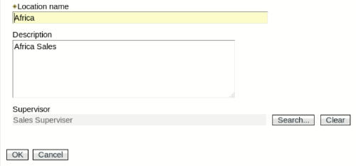
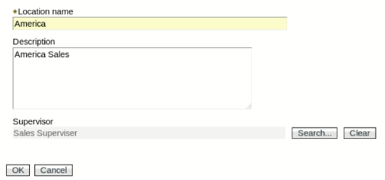
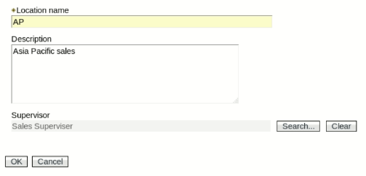
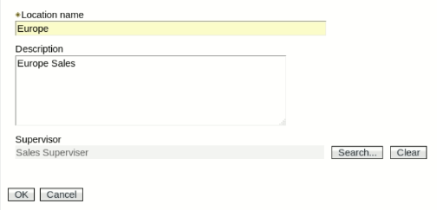
Location Creation
Africa
America
Asia-Pacific
Europe

Slide 10
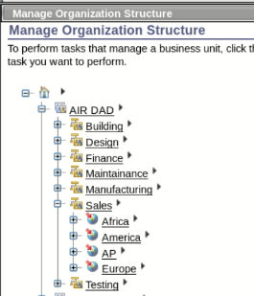
Organization Structure
Departments
Design
Manufacturing
Building
Testing
Sales
Maintenance
Financial
Locations
America
Europe
Africa
Asia - Pacific

Slide 11
User Creation Details
Users were divided based on the departments available in the company.
Users are given title as :
Helicopter
Commercial
Space
The title indicated the type of aircraft they will be working with.
The details on the number of employees, managers and admins is on the following slide.

Slide 12
User Details
Admins (3)
AIR Dhairya
AIR Darsh
AIR Aayushi
Supervisor(7)
Design Supervisor
Manufacturing Supervisor
Building Supervisor
Testing Supervisor
Sales Supervisor
Maintenance Supervisor
Finance Supervisor
Employees(376)
Design (19)
Manufacturing (39)
Building (102)
Testing (57)
Sales (41)
Maintenance (53)
Finance (65)

Slide 13
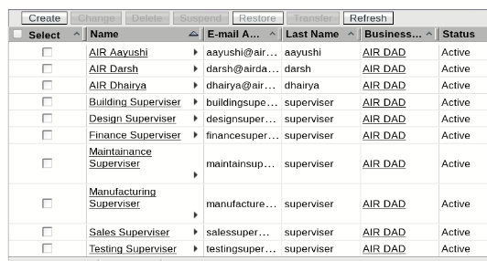
User Creation
Admins
AIR Dhairya
AIR Darsh
AIR Aayushi
Supervisors
Design Supervisor
Manufacturing Supervisor
Building Supervisor
Testing Supervisor
Sales Supervisor
Maintenance Supervisor
Finance Supervisor

Slide 14
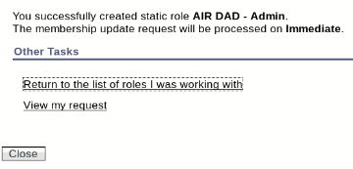
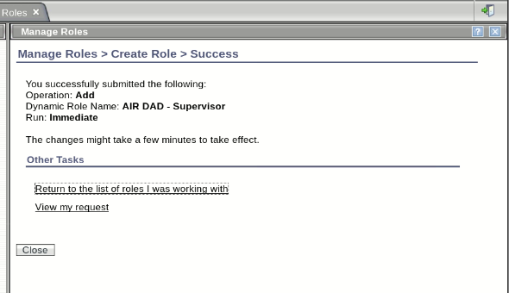
Role Creation
Admin Role (Static)
Supervisor Role (Dynamic)
Supervisor were given a dynamic role as the company plans to add more supervisor in the future, whereas admins are fixed.

Slide 15
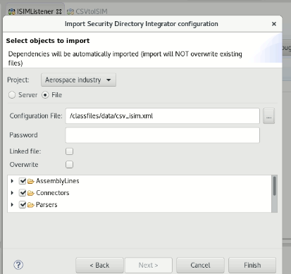
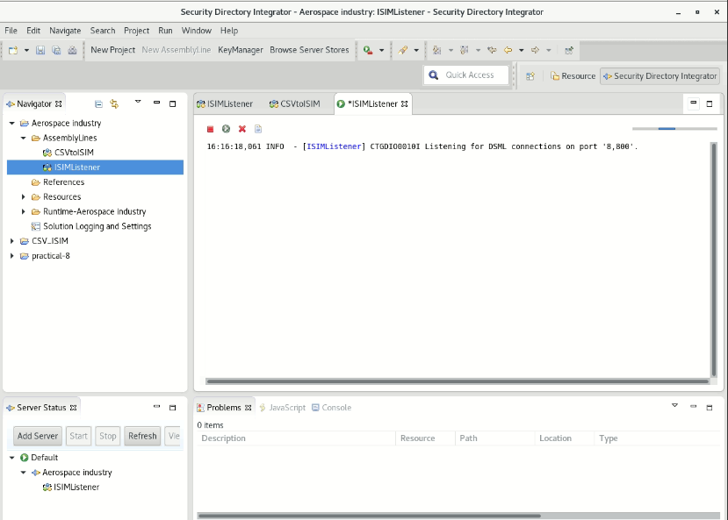
Service to add users
IDI Service – Using Security Directory Integrator to convert CSV to ISIM

Slide 16
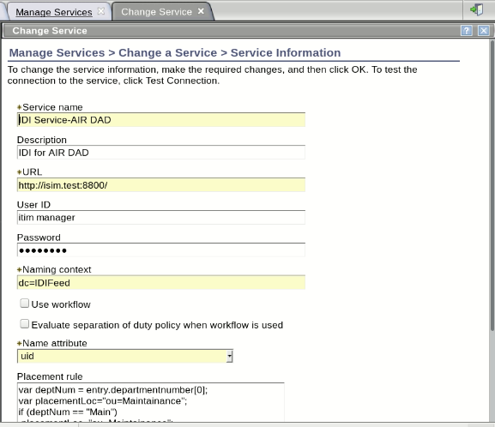
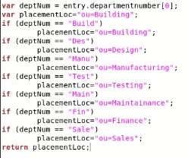
IDI service creation

Slide 17
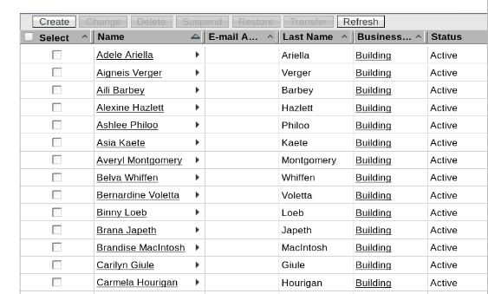
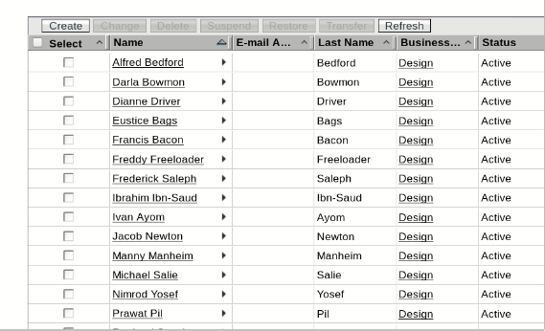
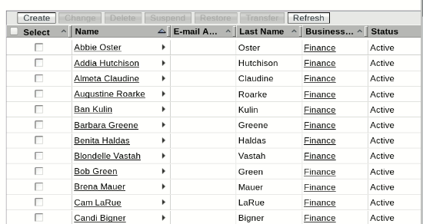
Building department
Design Department
Finance Department

Slide 18
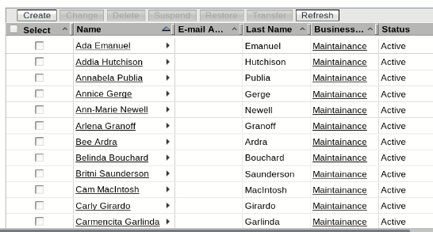
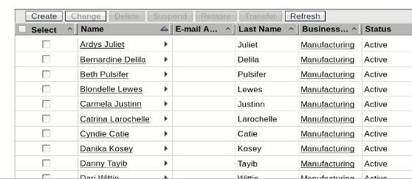
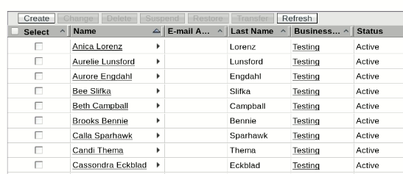
Manufacturing Department
Maintenance Department
Testing Department

Slide 19
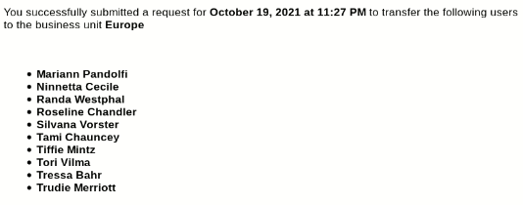
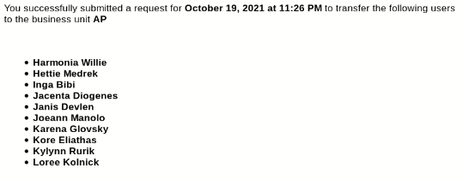
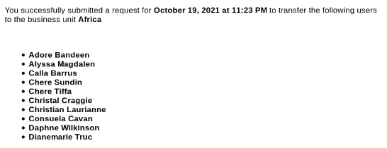
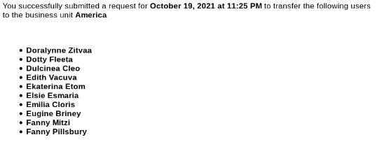
Europe Sales
Asia-Pacific Sales
Africa Sales
America Sales

Slide 20
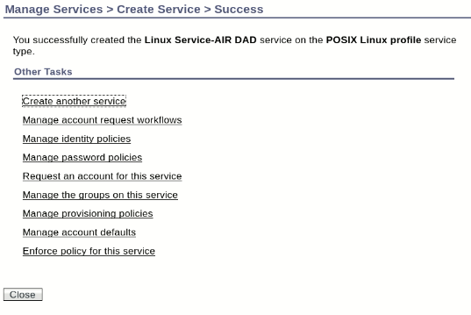
Service for policy creation
Linux Service
It will be used for all the policies that will be created in future
It is currently being used for 3 policies namely :
Password
Identity
Provisioning

Slide 21
Password Policy Details
The minimum length of password is 6 characters.
The password must contain at least 1 uppercase alphabet, 1 lowercase alphabet, 1 number and 1 unique character.
The password must contain special characters (@,$,#,%,&).
The password must not be same as username (both case sensitive and insensitive).
The password must not be same as uid (both case sensitive and insensitive).

Slide 22
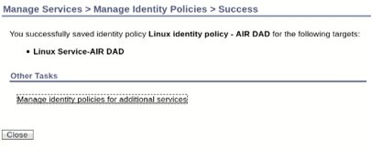
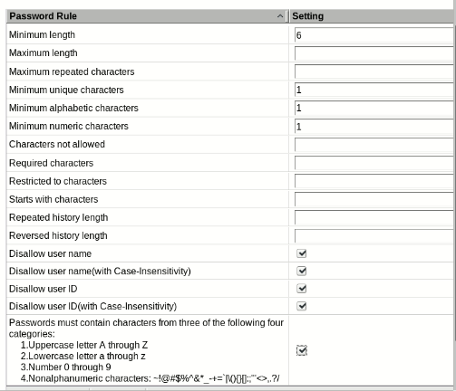
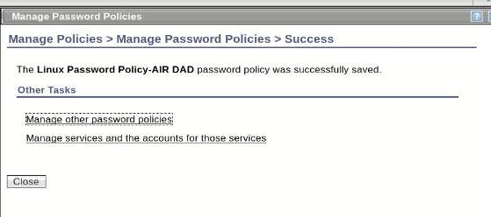
Policy Creation
Identity Policy
Password Policy

Slide 23
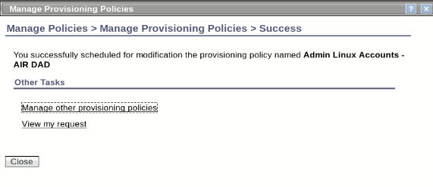
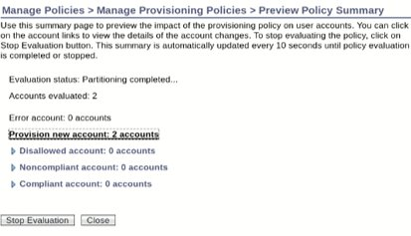
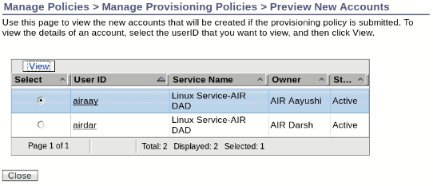
Provisioning Policy

Slide 24
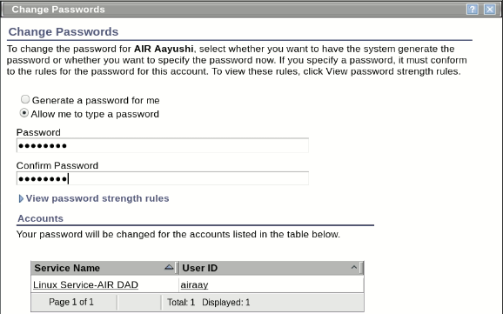
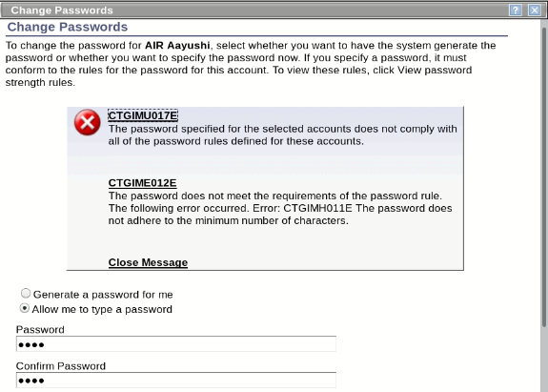
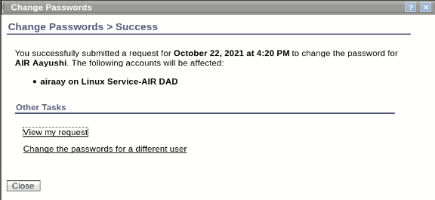
Password Policy Verification

Slide 25
Other Information
All the project work was done on the college system number 104 in lab 421.
The system was being used remotely via Any Desk.
The main tool used for the project was ISIM v6.0.2.
The tool used for data generation in csv format was :- CSV Generator.

Slide 26
Thank You

